Slide 1
Web Crawling and Scraping Agent using TF-IDF
University of Technology (Yatanarpon Cyber City)
Faculty of Information and Communication Technology
Department of Information Science
Third Seminar
Supervised by
Dr. Nandar Win Min
Presented by
Thaw De Zin (6IST-66)

Slide 2
Outline
Abstract
Objectives
Scope of Thesis
Field Background
System Design
Output
Conclusion
Further Extensions

Slide 3
Abstract
Web scraping is an automated process for finding and extracting data from on-line sources.
It is also referred to as automated data collection, web extracting, web crawling, or web content mining.
It commonly used in price comparison, president election, brand promoting and miscellaneous purposes.
The proposed system is to develop web agent for people to choose which products they should buy.
The web crawler is used to get information about products across the web resources.
In this system, during crawling the entire website pages/links, TF-IDF will be used to filter the pages/links about the product (laptop).
The most relevant laptops can be searched according to the user input using Levenshtein distance.

Slide 4
Objectives
To understand how a crawler and search engine works
To study web scraping use cases and applied areas
To develop simple web scraping tool for choosing suitable product from e-commerce websites.
To help people in finding the products that they want in a short period of time.

Slide 5
Scope of Thesis
This system crawl maximum of 3 websites.
http://www.linnonlinestore.com
http://www.royalsmartmm.com
http://www.sln-myanmar.com
Frequently changed layout of website will not be processed.
The working product is only specific one. (Example., Laptops)

Slide 6
Field Background
Web Crawling
Crawling
Indexing (TF*IDF)
Web Scraping
Ranking (HTML Parsing)
Searching
Levenshtein Distance

Slide 7
Web Crawling
The major search engines on the Web all have such a program, which is also known as a "spider" or a "bot."
Crawlers consume resources on visited systems and often visit sites without approval.
A crawler is a program that visits Web sites and reads their pages and other information in order to create entries for a search index.
Crawlers are typically programmed to visit sites that have been submitted by their owners as new or updated.
Entire sites or specific pages can be selectively visited and indexed.
Crawlers apparently gained the name because they crawl through a site a page at a time, following the links to other pages on the site until all pages have been read.

Slide 8
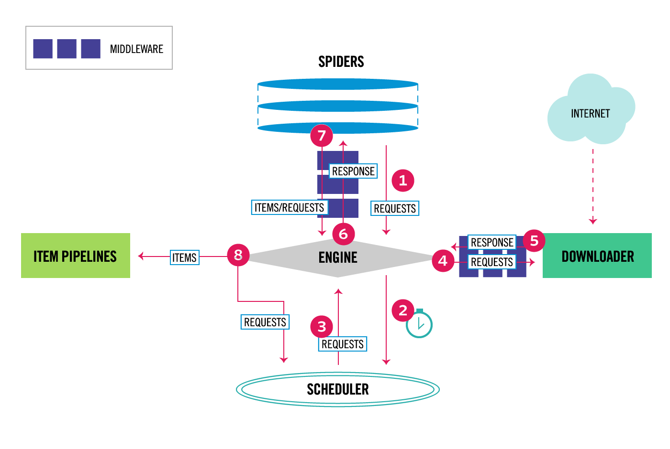
Scrapy Framework Architecture
Image Source :
https://docs.scrapy.org/en/latest/topics/architecture.html
Figure 1: Scrapy Framework Architecture

Slide 9
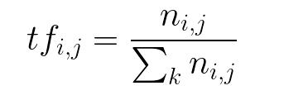
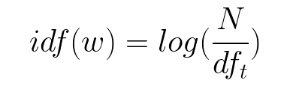
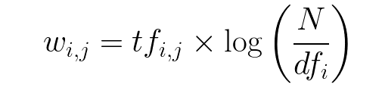
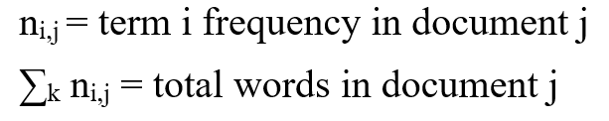

TF*IDF
TFIDF is a numerical statistic that is intended to reflect how important a word is to a document in a collection or corpus.
Equation 1: Term Frequency
Equation 2: Inverse Data Frequency
Equation 3: TF*IDF

Slide 10
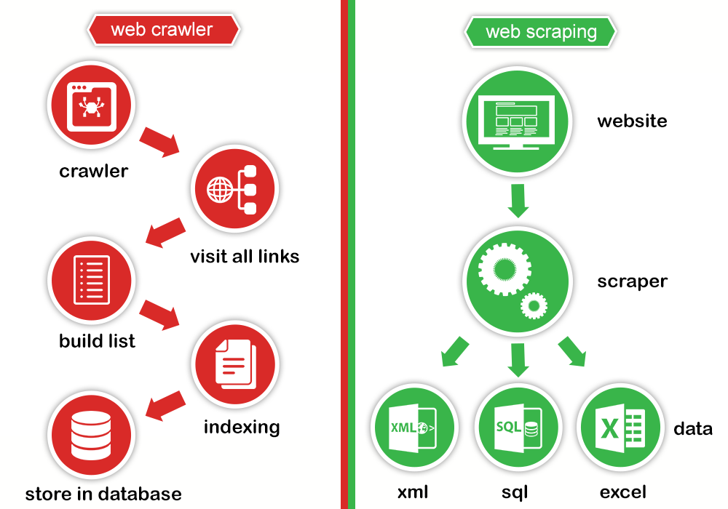
Web Crawler and Web Scraper
Figure 1: Web Crawler and Web Scraper
Image Source :
http://prowebscraping.com/web-scraping-vs-web-crawling

Slide 11
HTML Parsing
Top Down Parsing
Tree Structure (Depth First Tree Transversal)
Name = response.css(“h2::text”).extract()
Normalization

Slide 12
Basic Layout to Tree Structure
html
<html>
<head>
<title> <title>
</head>
<body>
<p>
<h1></h1>
<a></a>
</p>
<div>
<img>
<ul></ul>
</div>
</body>
</html>
head
body
p
div
title
h1
a
img
ul

Slide 13
Edit Distance Algorithm
The minimum edit distance between two strings
minimum number of editing operations
Insertion
Deletion
Substitution
Needed to transform one into the other

Slide 14
Edit Distance Algorithm
Suppose we have two strings x,y
e.g. x = kitten
y = sitting
and we want to transform x into y.
We use edit operations:
insertions
deletions
substitutions

Slide 15
Levenshtein Distance
A closer look:
k i t t e n
s i t t i n g
1st step: kitten →sitten (substitution)
2nd step: sitten→sittin (substitution)
3rd step: sittin→sitting (insertion)

Slide 16
System Design for Crawling
Start
Pages/
Links
Crawl entire 3 websites
Filter the Laptop pages using IT-IDF
Extract laptop’s features
Normalization for
laptop entry
Normalized laptop list
End

Slide 17
System Design for Searching
Start
Laptop’s feature
Retrieve relevant laptop by using Levenshtein distance
Normalized laptop list
Relevant laptops
End

Slide 18
User Input Limitations
Specification
Price
Brand
Available format!
S+B
S+P
B+P
B+S+P is not available

Slide 19
Output
The output is a user friendly web crawling and scraping Agent which is useful for searching the laptops that match the user input.

Slide 20
Conclusion
Web Crawling and Web Scraping are the most fundamental aspect in every Search Engine.
The system helps to understand how Search Engine works.
The user can get the information about the suitable product during a short period of time without the need for visiting too many websites.
User can also have advantages with the help of the algorithm in saving time and fuzzy choosing because the most relevant items are showed.

Slide 21
Further Extensions
The entire system can be upgraded using Distributed Crawling Techniques.
For the user convenience, the more items such as mobile phones, printer, projectors and so on should be crawled.

Slide 22
Thank You

